Slide 1

Group 14
Aarush, Gautam, Eric, Victoria, Emily, Srideep, Carl, Mark, Nilay, Travis

Slide 2
Statement of purpose
Create an application that features a collection of games that are both fun and functional
Design games such as matching card games, sequence memory challenges, and reaction time tests that will not only entertain our users but also provide meaningful benchmarks of human performance
Our platform will be designed to be accessible for all age groups
Our platform will be engaging for users with a wide range of interests
The application will have customization features to allow users to make it the experience they want
We strive to deliver reliable, smooth gameplay with robust backend logic

Slide 3

Risks and Rabbit Holes

Slide 4
Concurrency
No one on our team has prior experience in online game development and choosing an idea that will require concurrent sessions and data transfer between users is most likely out of our expertise
Additionally, this runs the risk of a bad user experience due to our inability to protect against exploits

Slide 5

Non-local processing
For UX and feasibility purposes, we want to focus on experiences that can run well locally, and only call home to the server or require serve computation/load when needed instead of every time
This allows the user to have a faster, low latency experience
This also reduces hosting costs on our side

Slide 6
Complicated UI
We have a talented front end team
We should try not to get too ambitious with our visuals to the point that our backend logic and application stability falls through
We should also keep the end user in mind, and consider whether our target audience wants the UI features we are capable of developing or not

Slide 7
Scalability obsession
Since our idea is more of a platform of multiple card games, we shouldn't become obsessed with making multitudes of games.
This will spread our focus
It will reduce the depth of technical features we can support
It will also take us away from the main goal of creating a game that is flushed out with all its features.
Quality > Quantity

Slide 8
Leaderboards
One of the features that our group is really excited to learn about and work on is leaderboards
We should keep our expectations realistic.
None of us have experience in doing this, so there is a high time/effort risk
We have to remember that while simple leaderboards help support the game, complicated leaderboards only add a minimal amount to the user experience

Slide 9

User personas

Slide 10
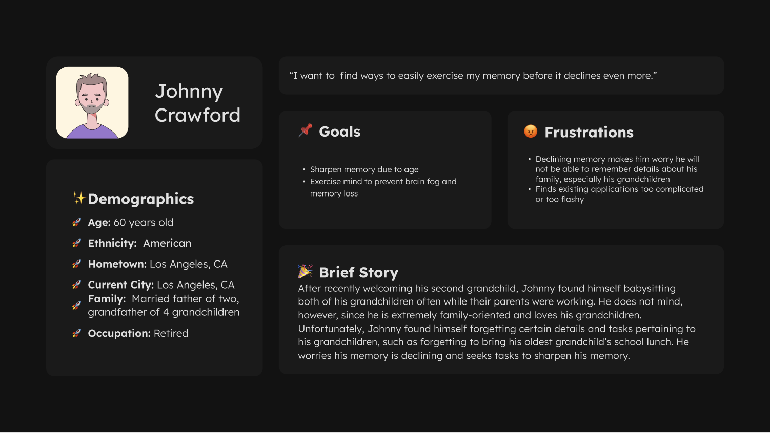

Slide 11
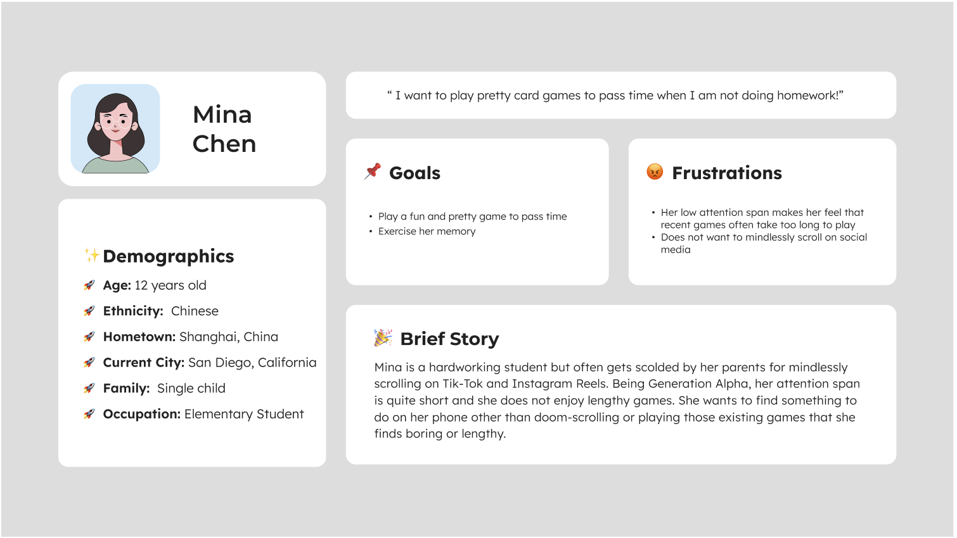

Slide 12
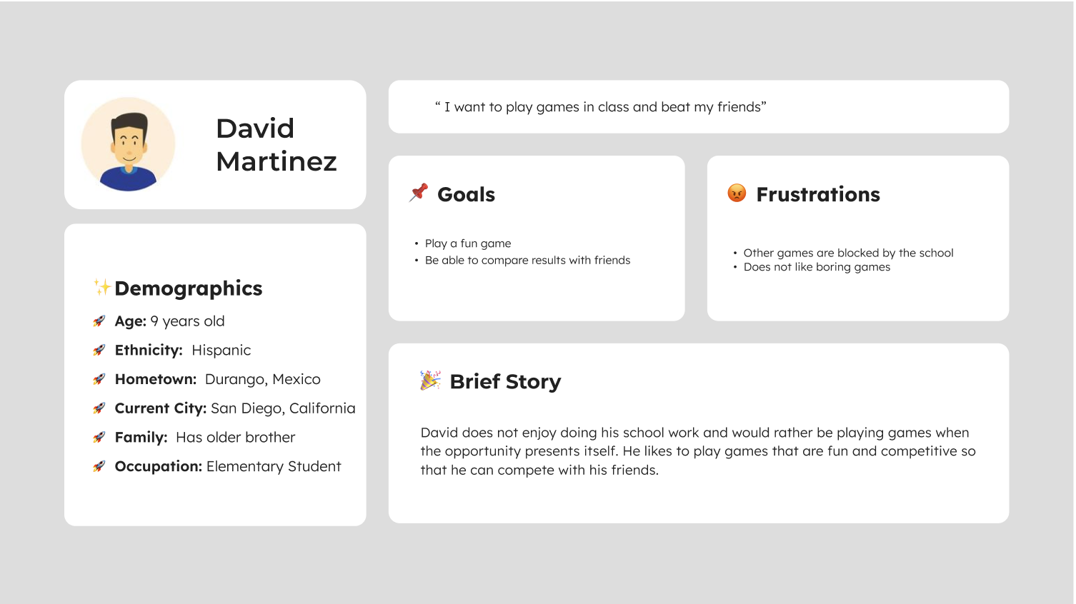

Slide 13


Slide 14
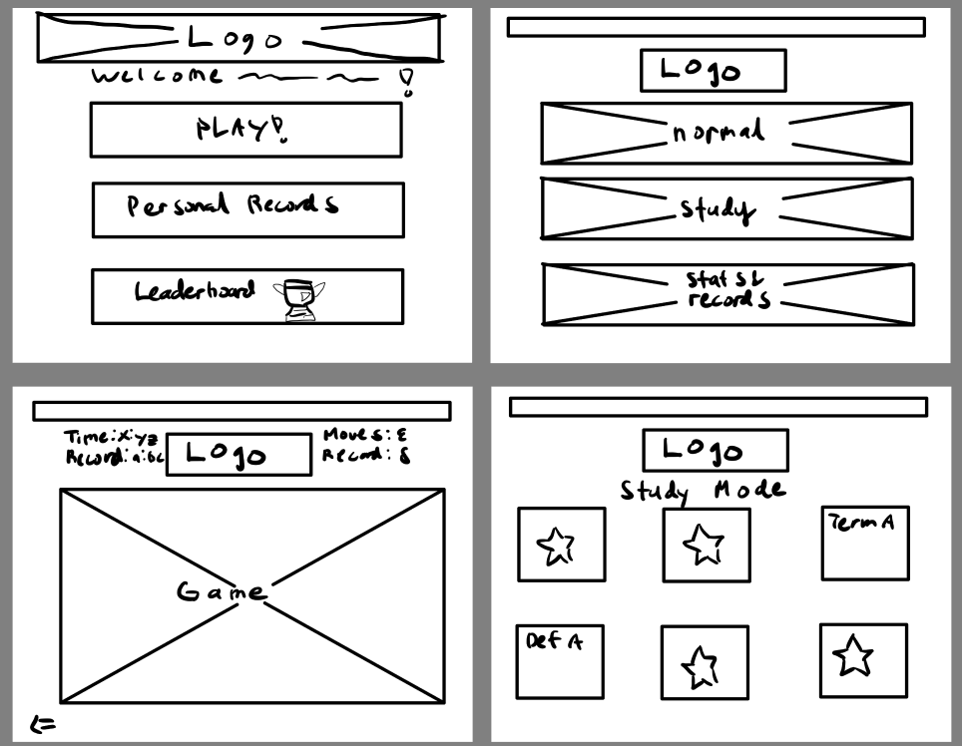
Wireframes

Slide 15
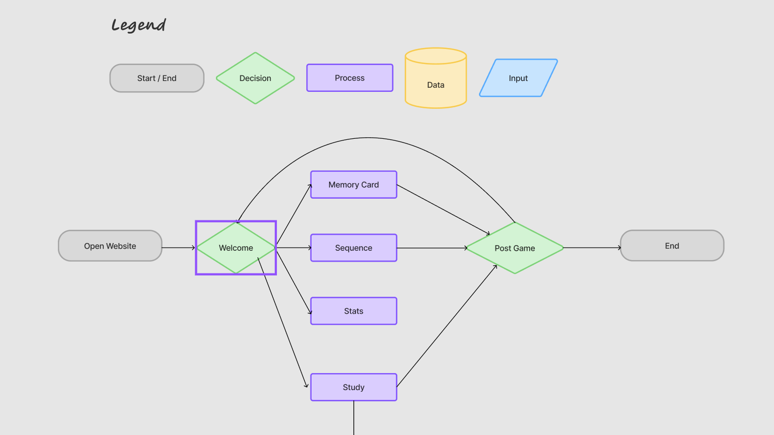
System diagram

Slide 16
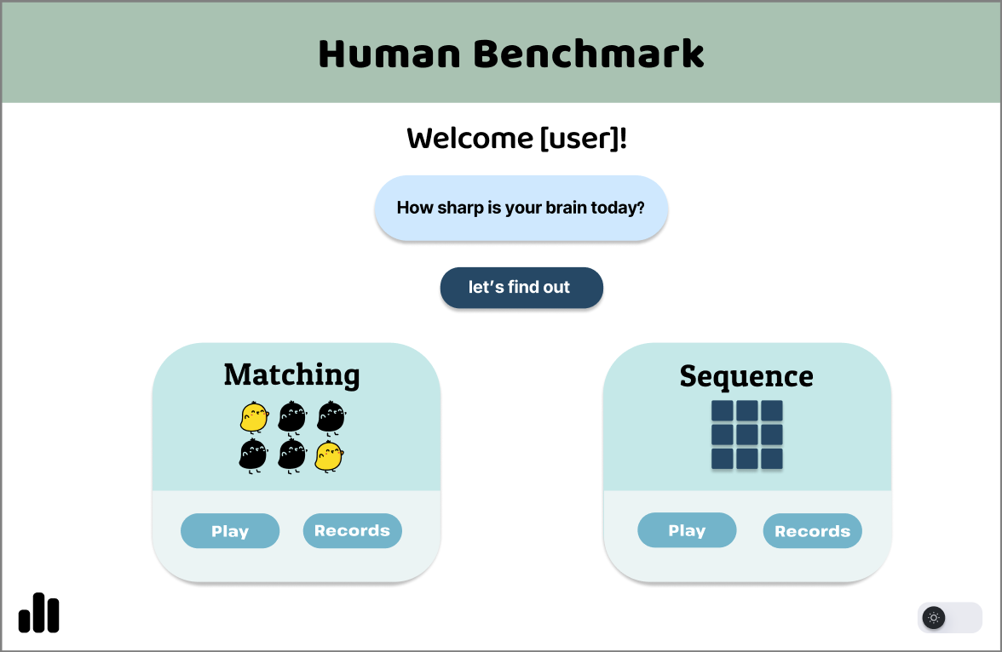
Visual Mock-Up: Homepage

Slide 17
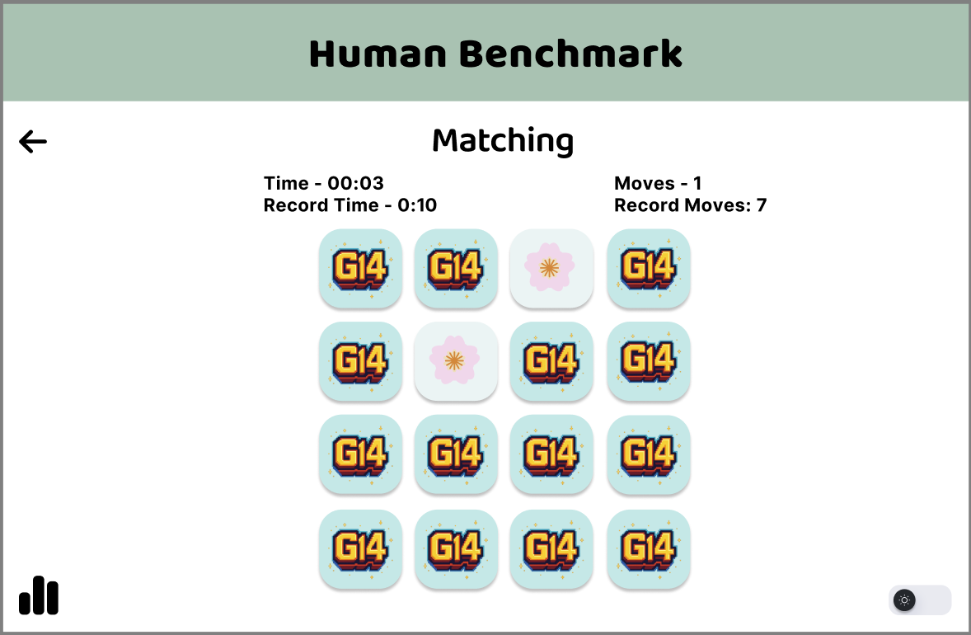
Matching Game and features

Slide 18
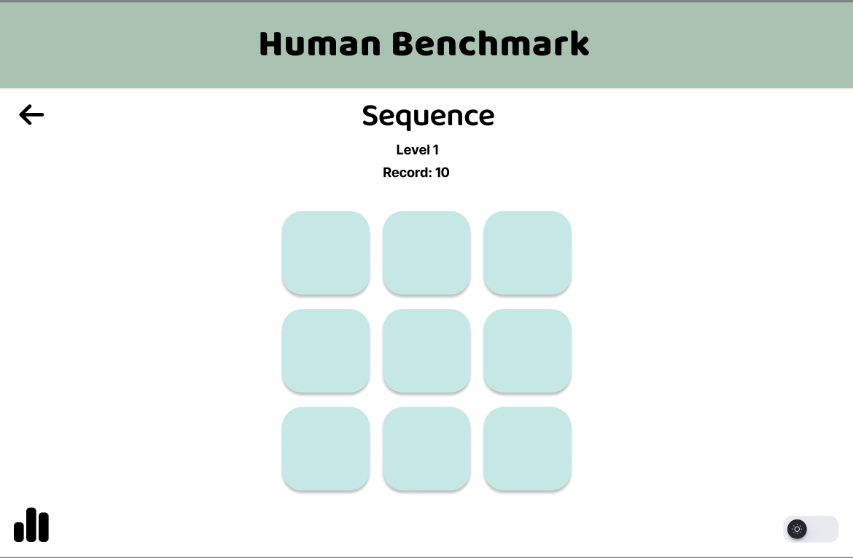
Visual Mock-Ups: Sequence memory game

Slide 19
Project roadmap
In Depth Planning and Research Phase (2 - 3 days)
Select Key Game that we want to implement (Matching Cards Game)
Research Base Tech Stack for similar games/sites
Set an MVP
Homepage + 1 mini game + records tracking + local leaderboard
Thorough Front-End leaning into team strengths
Start Developing MVP (1 week)
Implement Finalized Design of Homepage shown previously
Focus on page navigation and ease of use
Develop our Key Game
Add localized leaderboard once game logic is working
Scale Up # of games once MVP is fully flushed out (2 weeks)
Sequence Memory Game
Reaction Time Game
Joint leaderboard
Conduct Thorough testing from User Personas’ perspective (2 days)
Beautify UI and overall Frontend (1 week)
Start implementing extra features like the customization of cards/themes and dark mode
Add intricate animations
Overall Testing (remaining time)

